Slide 1
Tennis Star Recommender
Hello!
Capstone Project by
Aidan Dominguez

Slide 2
Problem Statement
In professional tennis, what are key statistics that determine whether a player is elite, really good, or average?
Can a model be made to predict future tennis stars from these statistics?
Notes:
X MINUTES
TALKING POINTS
This is a suggested talking point.
This is another.
TEACHING TIPS
This is a suggestion for the instructor on something to do before, during or after presenting this slide.
This is another suggestion.

Slide 3

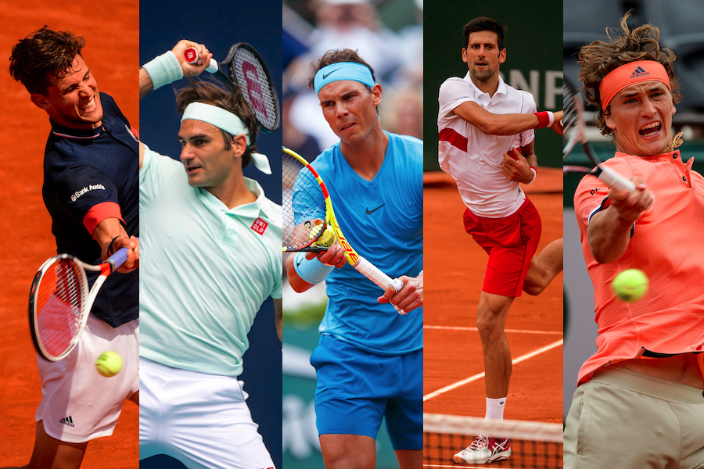
Background
Association of Tennis Professionals (ATP)
Notes:
X MINUTES
TALKING POINTS
This is a suggested talking point.
This is another.
TEACHING TIPS
This is a suggestion for the instructor on something to do before, during or after presenting this slide.
This is another suggestion.

Slide 4
Workflow
Find data
Clean and combine data
Analyze player statistics
Model
Recommend players to sponsors

Slide 5
Data Collection
Notes:
X MINUTES
TALKING POINTS
This is a suggested talking point.
This is another.
TEACHING TIPS
This is a suggestion for the instructor on something to do before, during or after presenting this slide.
This is another suggestion.

Slide 6

Data Collection
3 datasets:
Rankings 1973 - 2017
Match scores 2017
Match Stats 2017
Datahub.io
username: sports-data
https://datahub.io/sports-data/atp-world-tour-tennis-data

Slide 7
Data Cleaning
Rankings
Drop all data before 2017
Change ranking change feature from monthly to yearly
Stats / Scores
Drop unnecessary columns
Hyperlinks, tournament order, round number, etc.
Notes:
X MINUTES
TALKING POINTS
This is a suggested talking point.
This is another.
TEACHING TIPS
This is a suggestion for the instructor on something to do before, during or after presenting this slide.
This is another suggestion.

Slide 8
EDA
Notes:
X MINUTES
TALKING POINTS
This is a suggested talking point.
This is another.
TEACHING TIPS
This is a suggestion for the instructor on something to do before, during or after presenting this slide.
This is another suggestion.

Slide 9
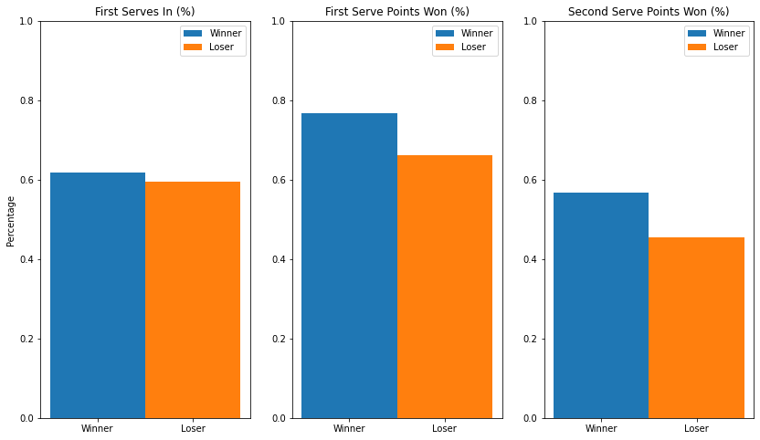
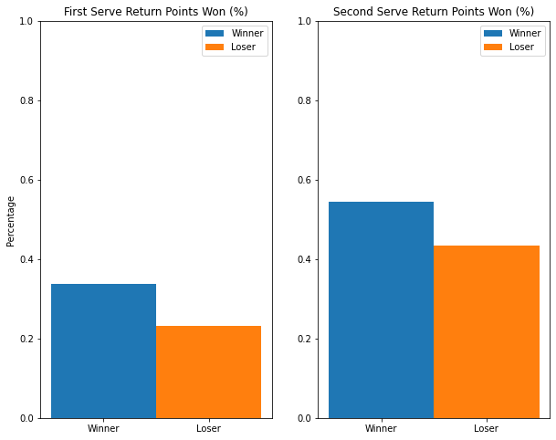
Winners vs Losers
Large differences:
10%
Exception:
First Serves In (%)
Notes:
X MINUTES
TALKING POINTS
This is a suggested talking point.
This is another.
TEACHING TIPS
This is a suggestion for the instructor on something to do before, during or after presenting this slide.
This is another suggestion.

Slide 10
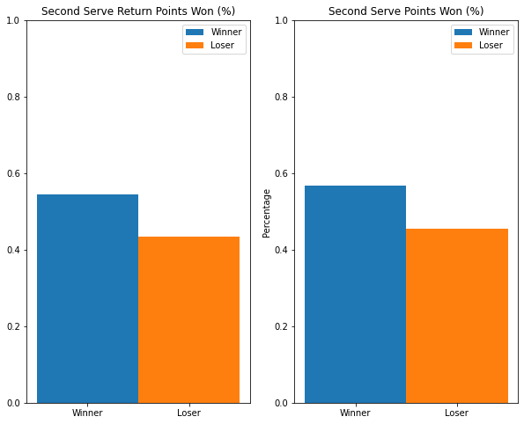
Returns?
Winner Second Serve Return Points Won > Loser Second Serve Points Won!
Notes:
X MINUTES
TALKING POINTS
This is a suggested talking point.
This is another.
TEACHING TIPS
This is a suggestion for the instructor on something to do before, during or after presenting this slide.
This is another suggestion.

Slide 11
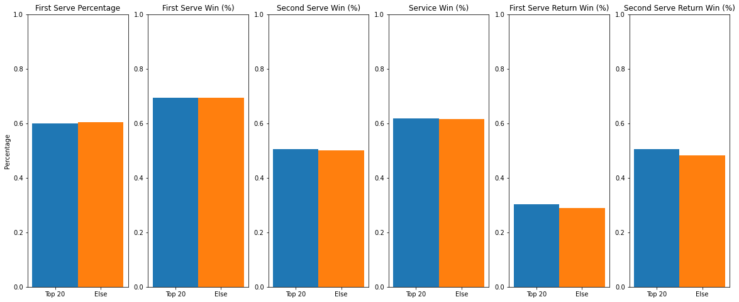
Defining the Top 20
Service Returns!

Slide 12
Interesting...
None of the current top 10 players were in the top 10 for service game win percentage, 1st serve win percentage, or 1st serve percentage
Don’t need the best serve if you can neutralize opponent’s serve
Exception: Daniil Medvedev (First serve win percentage)

Slide 13
Modeling
Notes:
X MINUTES
TALKING POINTS
This is a suggested talking point.
This is another.
TEACHING TIPS
This is a suggestion for the instructor on something to do before, during or after presenting this slide.
This is another suggestion.

Slide 14
K-Means
9 features + interaction terms
All features engineered
Extra engineering: matches played, climb rate

Slide 15
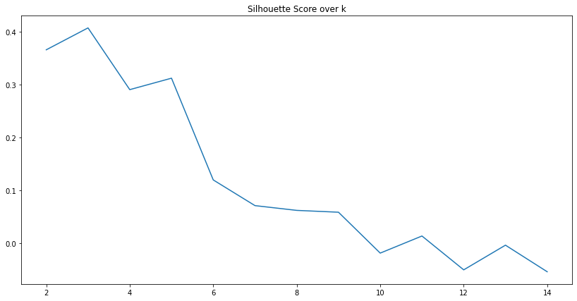
Silhouette Score
Highest silhouette score: 0.41 for k = 3
Why so low?
1 - 2% difference between top players

Slide 16
Results!

Slide 17
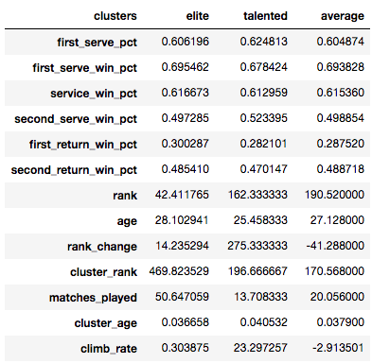
Results
3 clusters:
Elite
Talented
Average
Focused on elite category
Ages 17 - 24

Slide 18
Analysis
Elite vs Talented
Elite vs Average
2% advantage
First serve win percentage
Second serve return win percentage
1% advantage
Service game win percentage
First serve return
2% disadvantage
First serves in percentage
Second serve win percentage
1% advantage
First serve win percentage
First serve return win percentage
Similar stats otherwise

Slide 19
What can we conclude?
First serves!
Talented players have higher first serve percentage & second serve win percentage
Big Servers
Differentiates Talented players from Average players
Returns!
Elite and Average players have higher return percentages
Elite have higher first serve & first serve return win percentages
Average players have neither great serves nor great returns
Other factors
Mental Game, Opponents

Slide 20
Predictions
Notes:
X MINUTES
TALKING POINTS
This is a suggested talking point.
This is another.
TEACHING TIPS
This is a suggestion for the instructor on something to do before, during or after presenting this slide.
This is another suggestion.

Slide 21
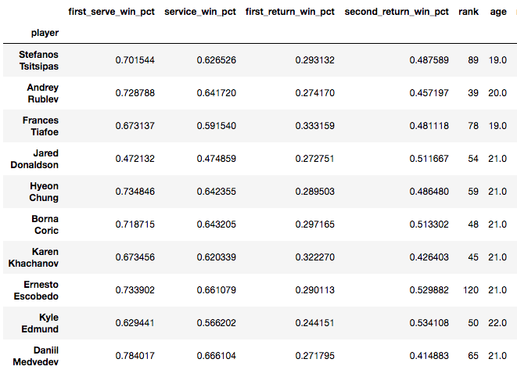
Next gen stars?
1 - 9% better first serve win percentage
6 / 10 players
Ranking range: 39 - 120
All under 22 years old or younger
All in top 60
90% top 50
60% in top 20
30% in top 10

Slide 22
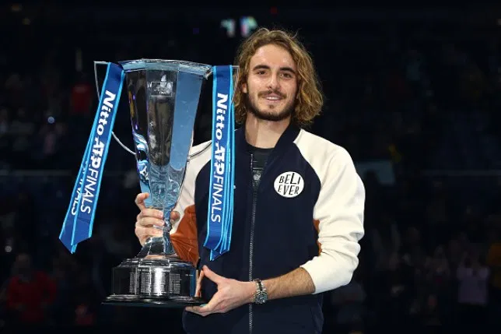
Stefanos Tsitsipas
2017 ranking: 89
Current ranking: 6
Highest ranking: 5
5 tournament wins
Nitto ATP Finals (2019)
2019 Australian Open Semi-Finalist
Beat Roger Federer in the 4th round
Lost to No. 2 seed Nadal

Slide 23
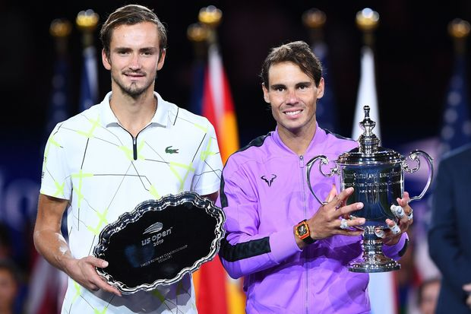
Daniil Medvedev
2017 ranking: 65
Current ranking: 5th
Highest ranking: 4th
7 tournament wins
2019 US Open Runner Up
Losing to No. 2 seed Nadal
Nearly 5 hour long match
Fought back from 2 sets down

Slide 24

Conclusions
Key statistics that differentiate players
First Serves
First Serve Returns
Able to forecast rising tennis stars from player statistics

Slide 25

Thank You!

